Slide 1
Lecture No. 4
Number Systems
Notes:
‹#›
In the last lecture we discussed the 32-bit floating point single precision format for representing very small, very large numbers and numbers having an integer part and a fraction part.

Slide 2
DEMINISHED RADIX SUBTRACTION
START
PADDING
TAKE r-1’s complement of Subtrend
ADD MENUEND to R-1’s Complement of SUBTREND
IF Carry
NO
-Take R-1’s Comp of Result
YES
ADD CARRY
RESULT

Slide 3
RADIX SUBTRACTION
START
PADDING
TAKE r’s complement of Subtrend
ADD MENUEND to R’s Complement of SUBTREND
IF Carry
NO
-Take R’s Comp of Result
YES
DISCARD CARRY
RESULT

Slide 4
BCD (Binary Coded Decimal) Code
Binary Code to represent decimal digits 0-9
Used by Decimal Number Displays
Notes:
‹#›
Most digital systems display a count value or the time in decimal on 7-segment LED display panels.
Since the numbers displayed are in decimal, therefore the binary code used to display the decimal numbers is designed to represent a single digit.
Consider a 2-digit 7-segment display that can display a count value from 0 to 99. To display the two decimal digits two separate binary codes are applied at the 7-segment display circuit inputs. Since each binary code has to specify a digit between 0 and 9 therefore only 10 different binary codes are required.
How many binary bits are required to represent 10 unique codes?
A 4-bit binary code allows 16 different binary combinations to be represented. Only the first 10, 4-bit binary codes are used, the remaining 6 codes are not used.
Thus displaying a 2-digit decimal number 79 would require the digital system to generate two BCD numbers 0111 and 1001 respectively

Slide 5
BCD (Binary Coded Decimal) Code
Decimal | BCD | Decimal | BCD
0 | 0000 | 5 | 0101
1 | 0001 | 6 | 0110
2 | 0010 | 7 | 0111
3 | 0011 | 8 | 1000
4 | 0100 | 9 | 1001
Notes:
‹#›
The Table shows the valid BCD codes.
A 4-bit binary code can represent up to 16 different values.
The 4-bit BCD code represents decimal digits 0 to 9 in binary.
Thus the binary code 1010, 1011, 1100, 1101, 1110 and 1111 are considered to be invalid BCD codes.

Slide 6
BCD Addition
How to ADD two BCD numbers:
Step 1: Add the two BCD numbers, using rule of binary Addition
Step 2:If 4-bit sum is equal to or less than 9, it is a valid BCD
Step 3: If a 4-bit sum is greater than 9. or if a carry out is generated, it is an invalid result. Add 6(0110) to four bit sum in order to skip six invalid states and return code to 8421. If a carry results when 6 is added, simply add the carry to the next 4-bit group
Notes:
‹#›
Consider the addition of two, 2-digit BCD numbers 23 and 45
BCD numbers are added using Binary addition method, resulting in 68
Consider the addition of two, 2-digit BCD numbers 23 and 49
Adding least significant digits 3 and 9 results in 12 represented as 1100.
1100 is an invalid BCD digit.
Secondly adding 3 and 9 in decimal should result in 2 as the sum and 1 as the carry.
The BCD result 0110 1100 is equivalent to 62 which is incorrect as the carry generated by the addition of the least significant digits has not been considered.

Slide 7
DECIMAL to BCD
253
(0010) 5 (0101) 3(0011)
253 (0010 0101 0011)

Slide 8
BCD to DECIMAL
100101100111
1001(9) 0110 (6) 0111(7)
100101100111 = (967)_{BCD}

Slide 9
BCD Addition
23 0010 0011
45 0100 0101
68 0110 1000
23 0010 0011
49 0100 1001
72 0110 1100
1100 is illegal BCD number
Notes:
‹#›
Consider the addition of two, 2-digit BCD numbers 23 and 45
BCD numbers are added using Binary addition method, resulting in 68
Consider the addition of two, 2-digit BCD numbers 23 and 49
Adding least significant digits 3 and 9 results in 12 represented as 1100.
1100 is an invalid BCD digit.
Secondly adding 3 and 9 in decimal should result in 2 as the sum and 1 as the carry.
The BCD result 0110 1100 is equivalent to 62 which is incorrect as the carry generated by the addition of the least significant digits has not been considered.

Slide 10
BCD Addition
Add a 0110 (6) to an invalid BCD number
Carry added to the most significant BCD digit
23 0010 0011
49 0100 1001
72 0110 1100
0110
0111 0010
Notes:
‹#›
When addition of BCD digits results in an invalid BCD number or a carry.
The number 0110 (6 decimal) is added to the result.
Reconsidering the addition of BCD 23 and 49. The addition of digits 3 and 9 results in 1100 an invalid BCD number
A 0110 decimal 6 is added which results in 0010 and a carry which is added to 0110 to result in 0111

Slide 11
BCD Subtraction
23 0010 0011
49 0100 1001
72 0110 1100
0110
0111 0010
Notes:
‹#›
When addition of BCD digits results in an invalid BCD number or a carry.
The number 0110 (6 decimal) is added to the result.
Reconsidering the addition of BCD 23 and 49. The addition of digits 3 and 9 results in 1100 an invalid BCD number
A 0110 decimal 6 is added which results in 0010 and a carry which is added to 0110 to result in 0111

Slide 12
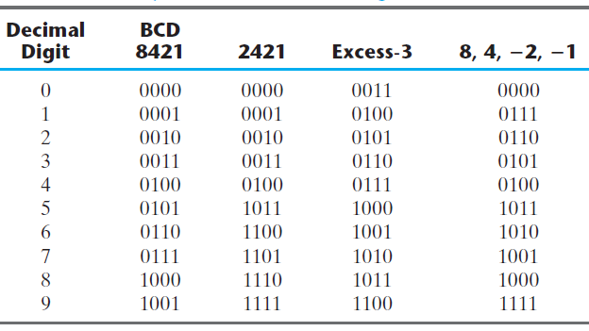
DECIMAL CODES

Slide 13
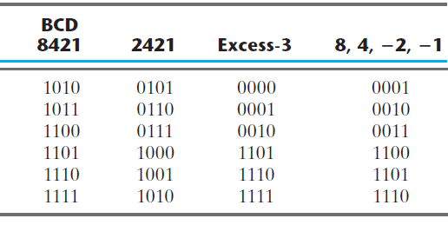
UNUSED COMBINATIONS

Slide 14
Excess Code
A bias is added to Binary Code
Used by floating point numbers

Slide 15
Excess-8 Code
Decimal | 2’s Comp. | Excess-8 | Decimal | 2’s Comp. | Excess-8
0 | 0000 | 1000 | -8 | 1000 | 0000
1 | 0001 | 1001 | -7 | 1001 | 0001
2 | 0010 | 1010 | -6 | 1010 | 0010
3 | 0011 | 1011 | -5 | 1011 | 0011
4 | 0100 | 1100 | -4 | 1100 | 0100
5 | 0101 | 1101 | -3 | 1101 | 0101
6 | 0110 | 1110 | -2 | 1110 | 0110
7 | 0111 | 1111 | -1 | 1111 | 0111
Notes:
‹#›
Consider the decimal number range +7 to -8.
These positive and negative decimal numbers can be represented by the 2’s complement representation.
The magnitude of positive and negative numbers can not be easily compared if the numbers are represented in 2’s complement form.
The decimal number range +7 to -8 is represented using an Excess-8 code that assigns 0000 to -8 the lowest number in the range and 1111 to +7 the highest number in the range.
Excess-8 code is obtained by adding a number to the lowest number -8 in the range such that the result is zero. The number is 8.
The number 8 is added to all the remaining decimal numbers from -7 up to the highest number +7.
The resulting code is Excess-8 code or Biased 8 code.

Slide 16
Gray Code
Binary Code more than 1 bit change
Electromechanical applications of digital systems restrict bit change to 1
Shaft encoders
Braking Systems
Un-Weighted Code

Slide 17
Gray Code
Decimal | Gray | Binary
0 | 000 | 000
1 | 001 | 001
2 | 011 | 010
3 | 010 | 011
4 | 110 | 100
5 | 111 | 101
6 | 101 | 110
7 | 100 | 111
Notes:
‹#›
Consider the 3-bit binary code and the 3-bit Gray code representing the decimal numbers 0 to 7.
The binary code is a positional code and the three bits starting from the least significant bit have the weights 1,2 and 4.
The Gray Code is not a positional code.
However, the change from one value to the next using the Gray code guarantees a single bit change.

Slide 18
Binary to Gray Code Conversion
To convert binary to gray code following steps are followed
Step1: The most significant bit in gray code is same as the corresponding MSB in the binary number.
Step 2: Going from left to right, add each adjust pair of binary code bit to get next gray code bit. Discard Carries.
Notes:
‹#›
Consider the 3-bit binary code and the 3-bit Gray code representing the decimal numbers 0 to 7.
The binary code is a positional code and the three bits starting from the least significant bit have the weights 1,2 and 4.
The Gray Code is not a positional code.
However, the change from one value to the next using the Gray code guarantees a single bit change.

Slide 19

Binary to Gray Code Conversion
For Example, the conversion of the binary number 10110 to Gray code :
The gray code is 11101
Notes:
‹#›
Consider the 3-bit binary code and the 3-bit Gray code representing the decimal numbers 0 to 7.
The binary code is a positional code and the three bits starting from the least significant bit have the weights 1,2 and 4.
The Gray Code is not a positional code.
However, the change from one value to the next using the Gray code guarantees a single bit change.

Slide 20
Gray Code to Binary Conversion
To convert gray code to binary following steps are followed
Step1: The most significant bit (left most) in binary code is same as the corresponding MSB in the gray code.
Step 2:Add each binary code generated to the gray code bit in next adjacent position. Discard carries.
Notes:
‹#›
Consider the 3-bit binary code and the 3-bit Gray code representing the decimal numbers 0 to 7.
The binary code is a positional code and the three bits starting from the least significant bit have the weights 1,2 and 4.
The Gray Code is not a positional code.
However, the change from one value to the next using the Gray code guarantees a single bit change.

Slide 21

Gray Code to Binary Conversion
For Example, the conversion of the Gray Code 11011 to binary
The Binary is 10010
Notes:
‹#›
Consider the 3-bit binary code and the 3-bit Gray code representing the decimal numbers 0 to 7.
The binary code is a positional code and the three bits starting from the least significant bit have the weights 1,2 and 4.
The Gray Code is not a positional code.
However, the change from one value to the next using the Gray code guarantees a single bit change.

Slide 22
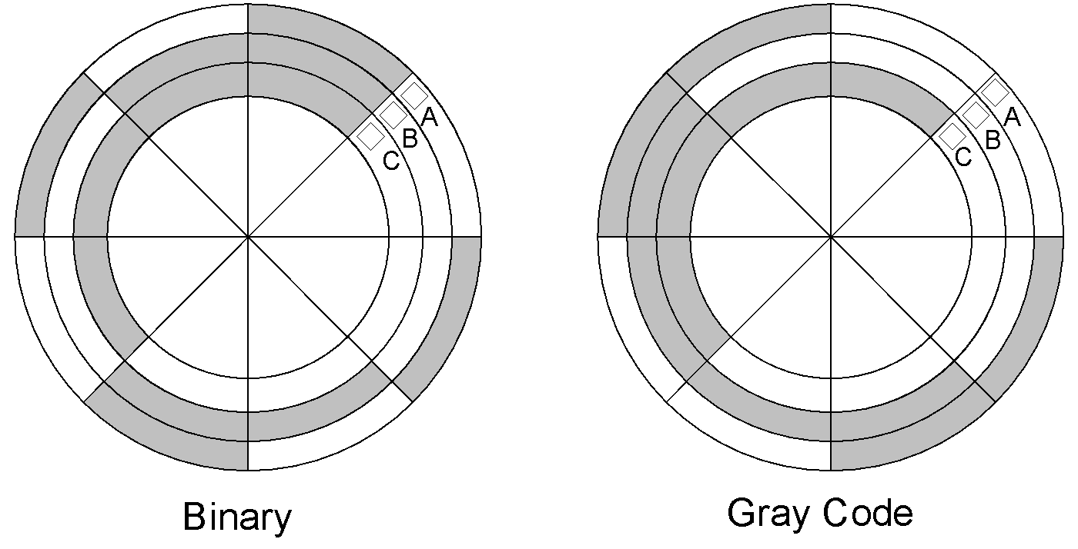
Gray Code Application
Notes:
‹#›
Consider the example of shaft encoders that best explain the utility of the Gray Code.
The Diagram shows a disk connected to the shaft of a rotating machine.
The shaded areas on the disk indicate conducting strips connected to +5 volts.
The non-shaded area indicate a non-conducting strips.
Three stationary brushes A, B and C touch the surface of the rotating disk.
The three brushes are connected to three LED lamps through wires.
As the disk rotates the brushes come in contact with the conducting area and the insulated area. The three LEDs display the position of the rotating shaft in terms of 3-bit numbers.
Consider the disk on the left. If the disk on the left rotates in the anti-clockwise direction by 45⁰ the Brush A comes in contact with the conducting strip at 5 volts, which turns on the LED indicating Binary 001.
If the disk continuous its rotation, after a rotation of another 45⁰, brush B comes in contact with the conducting strip and brush A comes in contact with the non-conducting strip. Thus LED connected to brush B lights up indicating binary 010.
Thus at any instant of time, the LEDs indicate the angular position of the rotating shaft in steps of 45⁰
Assume that the three brushes A, B and C are not aligned properly and Brush B is slightly ahead of brushes A and C.
Now if the disk rotates 90⁰ from its start position. Brush A is in contact with the conducting strip, Brush B due to its misalignment is in contact with the conducting strip and brush C is in contact with the insulated strip.
Thus when the disk rotates the LEDs will show a 001,followed by a 011 for a short duration when the disk rotates from 90⁰ to 91⁰ and then to 010.
Thus due to misalignment the count value jumped from 1 to 3 and then back to 2.
Consider the disk shown on the right. The conducting and non-conducting strips follow a Gray Code pattern 000, 001, 011, 010, 110, 111, 101 and 100 representing decimal 0, 1, 2, 3, 4, 5, 6 and 7.
Now even if the brushes are misaligned, the LEDs would always display the correct count value.

Slide 23
Alphanumeric Code
Numbers, Characters, Symbols
ASCII 7-bit Code
American Standard Code for Information Interchange
10 Numbers (0-9)
26 Lower Case Characters (a-z)
26 Upper Case Characters (A-Z)
32 Control Characters
Punctuation and Symbols

Slide 24
Alphanumeric Code
Extended ASCII 8-bit Code
Additional 128 Graphic characters
Unicode 16-bit Code

Slide 25
ASCII Code
Numbers 0 to 9
ASCII 0110000 (30h) to 0111001 (39h)
Alphabets a to z
ASCII 1100001 (61h) to 1111010 (7Ah)
Alphabets A to Z
ASCII 1000001 (41h) to 1011010 (5Ah)
Control Characters
ASCII 0000000 (0h) to 0011111 (1Fh)
Notes:
‹#›
Consider some of the ASCII codes that represent the numbers 0 to 9
The ASCII code 011 0000 which is also equivalent to 30h represents 0
The ASCII code 011 0001 which is also equivalent to 31h represents 1
The ASCII code 011 1001 which is also equivalent to 39h represents 9
ASCII codes 110 0001 (61h) to 111 1010 (7Ah) represent lower case alphabets a to z
ASCII codes 100 0001 (41h) to 101 1010 (5Ah) represent upper case alphabets A to Z
The 32 control characters are represented by ASCII code 000 0000 (0h) to 001 1111 (1Fh)

Slide 26
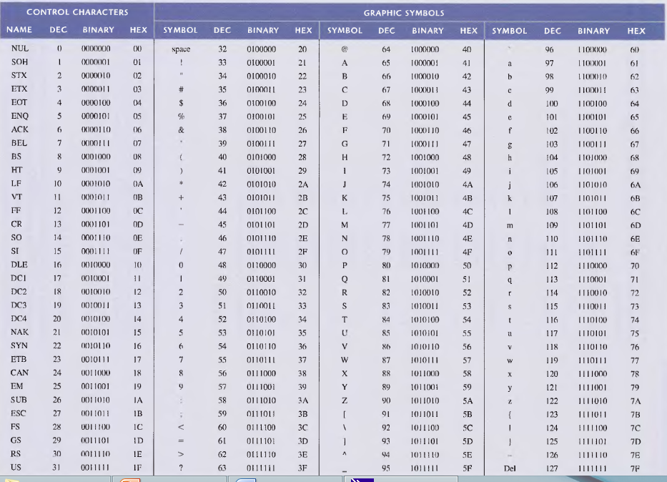
ASCII Code
Notes:
‹#›
Consider some of the ASCII codes that represent the numbers 0 to 9
The ASCII code 011 0000 which is also equivalent to 30h represents 0
The ASCII code 011 0001 which is also equivalent to 31h represents 1
The ASCII code 011 1001 which is also equivalent to 39h represents 9
ASCII codes 110 0001 (61h) to 111 1010 (7Ah) represent lower case alphabets a to z
ASCII codes 100 0001 (41h) to 101 1010 (5Ah) represent upper case alphabets A to Z
The 32 control characters are represented by ASCII code 000 0000 (0h) to 001 1111 (1Fh)

Slide 27
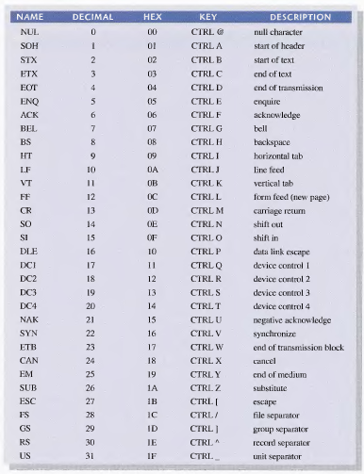
ASCII Code
Notes:
‹#›
Consider some of the ASCII codes that represent the numbers 0 to 9
The ASCII code 011 0000 which is also equivalent to 30h represents 0
The ASCII code 011 0001 which is also equivalent to 31h represents 1
The ASCII code 011 1001 which is also equivalent to 39h represents 9
ASCII codes 110 0001 (61h) to 111 1010 (7Ah) represent lower case alphabets a to z
ASCII codes 100 0001 (41h) to 101 1010 (5Ah) represent upper case alphabets A to Z
The 32 control characters are represented by ASCII code 000 0000 (0h) to 001 1111 (1Fh)

Slide 28
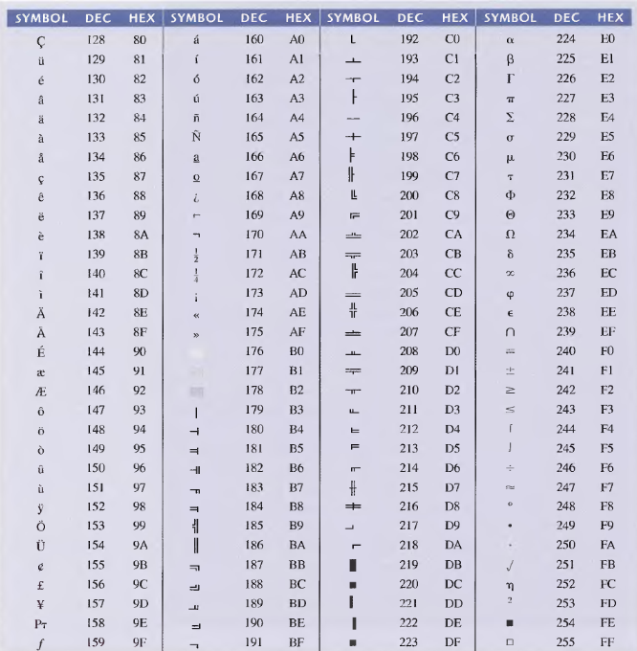
Extended ASCII Characters
Notes:
‹#›
Consider some of the ASCII codes that represent the numbers 0 to 9
The ASCII code 011 0000 which is also equivalent to 30h represents 0
The ASCII code 011 0001 which is also equivalent to 31h represents 1
The ASCII code 011 1001 which is also equivalent to 39h represents 9
ASCII codes 110 0001 (61h) to 111 1010 (7Ah) represent lower case alphabets a to z
ASCII codes 100 0001 (41h) to 101 1010 (5Ah) represent upper case alphabets A to Z
The 32 control characters are represented by ASCII code 000 0000 (0h) to 001 1111 (1Fh)

Slide 29
Error Detection
Digital Systems are very Reliable
Errors during storage or transmission
Parity Bit
Even Parity
Odd Parity

Slide 30
Odd Parity Error Detection
Original data 10011010
With Odd Parity 110011010
1-bit error 110111010
Number of 1s even indicates 1-bit error
2-bit error 110110010
Number of 1s odd no error indicated
3-bit error 100110010
Number of 1s even indicates error

